Slide 1



LibSpace API
A Robust Backend for Library Operations

Slide 2

Project Overview
What is LibSpace?
Core Capabilities
Microweb-basedlibrary
User registration & login CRUD operations on books Secure authentication flow
management system with secure authentication and book management features.

Slide 3

Technical Architecture
API Layer
Routeshandle HTTP requests using Node.js + Express.js
Business Logic
Controllersprocessauthentication and CRUD operations
Data Access
ModelsmanageMongoDB storage and data integrity

Slide 4
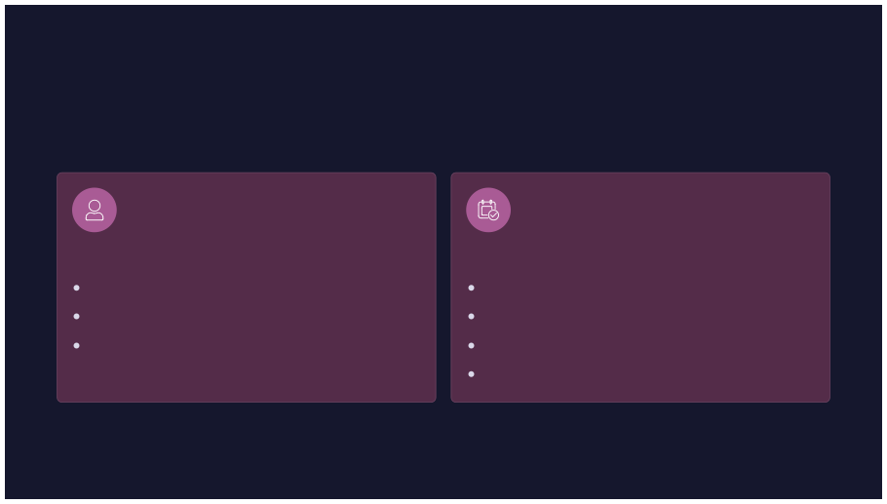
API Endpoints
User Routes
Book Routes
POST /register POST /login DELETE /delete
POST /add GET /books PUT /update DELETE /delete

Slide 5
Key Features
Secure Authentication
Book Management
User-Book Relationship
One-to-many relationship using MongoDB ObjectId references for data integrity
JWTtokens, bcrypt password hashing, protected routes with middleware verification
Full CRUDoperationswithuser-
specific book ownership and data protection

Slide 6

Database Structure
Users Collection
Books Collection
name, email,password Automatic timestamps Secure password storage
title, author,URL
User ObjectId reference Ownership tracking

Slide 7
Security Implementation
01
Input Validation
02
03
Password Hashing
JWT Generation
Required fields verification
bcrypt encryption
Token-basedauthentication
04
Route Protection
05
Token Blacklist
Middleware verification
Logout invalidation

Slide 8


User Flow
1
Register
Create account withcredentials
2
Login
Verifycredentials, receive token
3
Access
Use Bearer token for protectedroutes
4
CRUD
Managebooks with full operations
5
Logout
Invalidatesession

Slide 9

Project Setup
Configure .env
Install Dependencies
SetPORT,MONGO_URI, JWT_SECRET
npm install
Run Server
Start MongoDB
npmstartornpm run dev
Verify database connection

Slide 10

Technology Stack
Backend
Node.js + Express.js
Database
MongoDBwith Mongoose ODM
Security
JWT +bcrypt
API
RESTful endpoints

